Slide 1
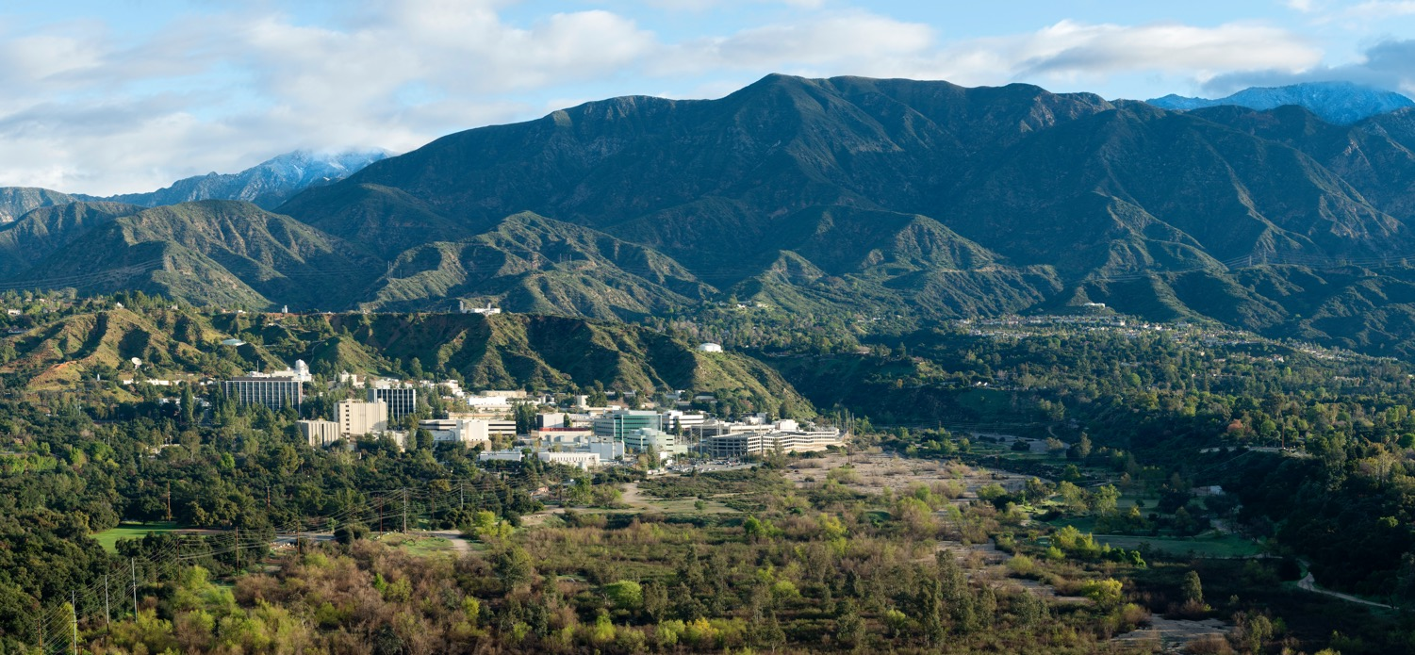



A Unified and Interactive Framework for Earth Science Intelligence
Aashish Panta, Edwin Goh, Kyo Lee, Valerio Pascucci
NASA JPL and University of Utah

Slide 2
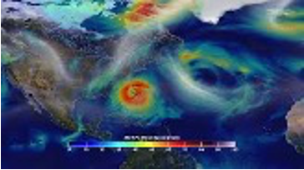

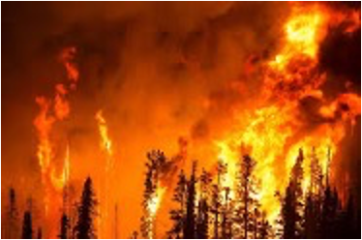
The Era of Large-scale Climate Data
Large volume of data being generated everyday,
especially in climate science
• Numerical models
• Satellites and airborne observations
• Ground-based stations
Why is it important?
Understanding Long-Term Environmental Trends
Climate Analyses Workflow
Support Decision-making
*CCL License images

Slide 3
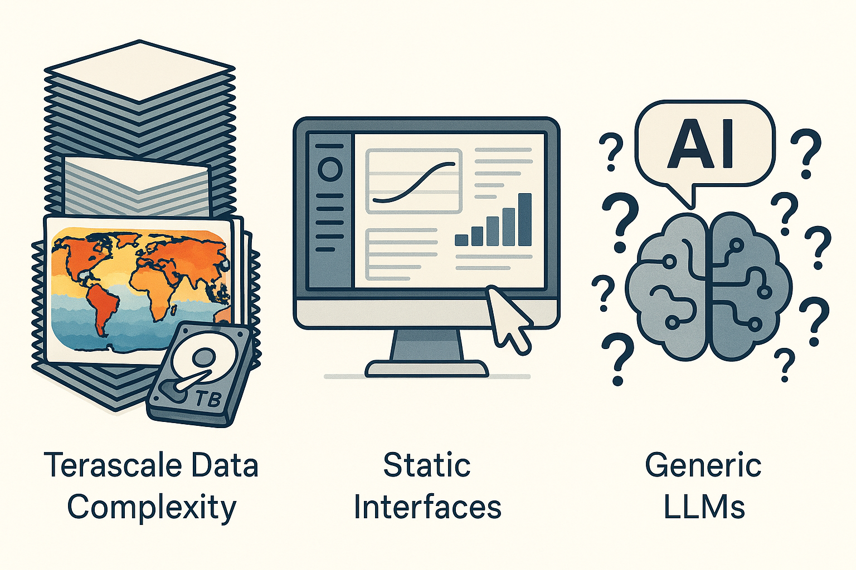
But these data come with their own challenges
Terascale Data Complexity
Terabytes of climate data such as the NASA Earth Exchange Global Daily Downscaled Projections (NEX-GDDP-CMIP6; ~ 30 TB) poses challenges to analyze and visualize the data in real time.
Static Interfaces
Traditional dashboards require expert knowledge of UI controls and query languages, slowing down exploratory analysis.
Generic large language models (LLMs)
Existing LLMs do not always address scientific queries, and often tend to hallucinate.

Slide 4
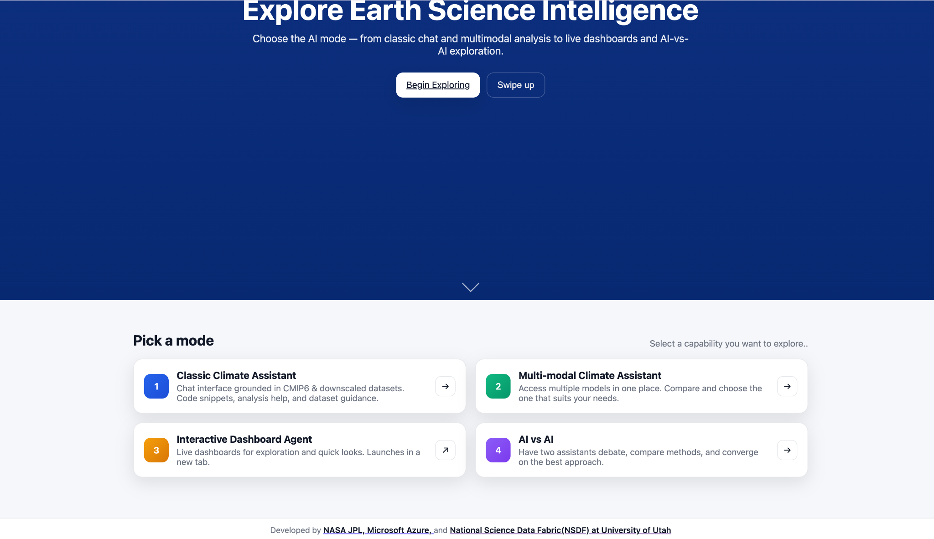
Our Approach
A unified and interactive interface providing:
Classic Climate Assistant:
Chat with a grounded-LLM, generate code
or run analyses code directly from the UI
Multi-modal Assistant:
Get answers from multiple deployed models,
choose the answer that suits your need
Interactive Dashboard Agent:
Explore and interact with terabytes of NEX-GDDP-CMIP6 datasets, directly from the
browser, with AI chat functionality.
AI vs AI Arena:
Give a prompt to the LLM and let them debate; opens up multiple angles for discussions.

Slide 5
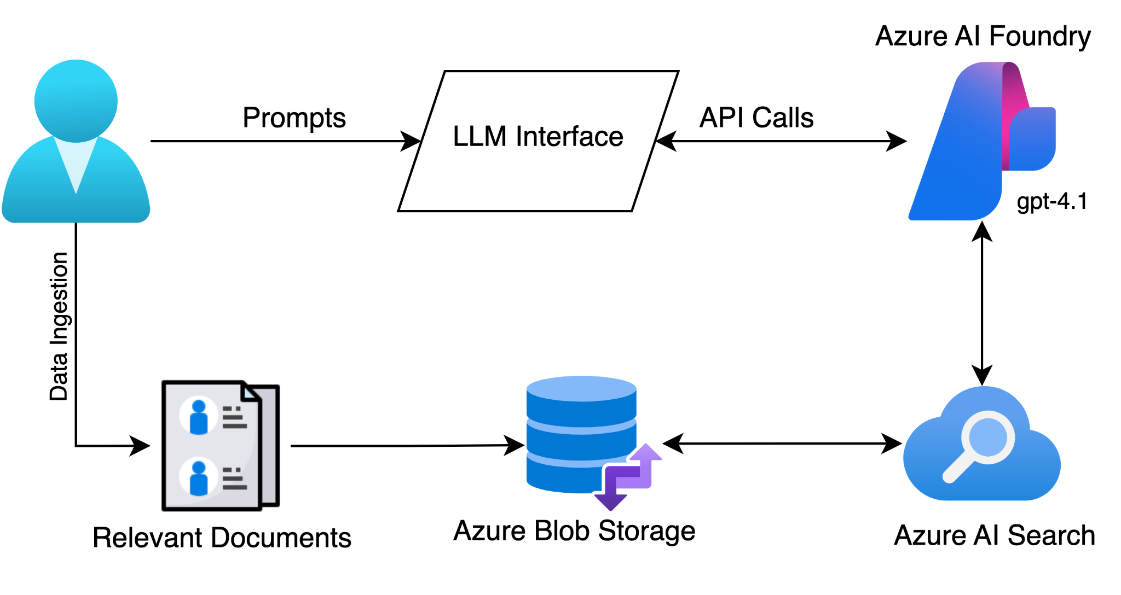
Our Workflow
We leverage:
RAG-powered LLMs
Leverage Azure services like Azure Blob Storage, Azure AI Search Service and
Azure Foundry Portal.
Voice-Enabled Agent
Integrate Whisper by OpenAI on the client-side for speech-to-text and an LLM backend for intent parsing
Interactive Visualization Dashboards with
NSDF
Real-time viewport pans, model swapping, and temporal navigation; all driven by natural-language commands.
Fig: Simplified workflow

Slide 6
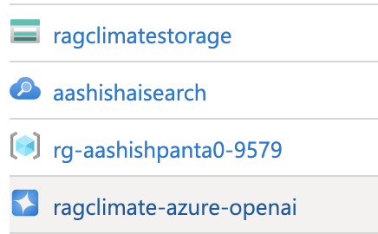
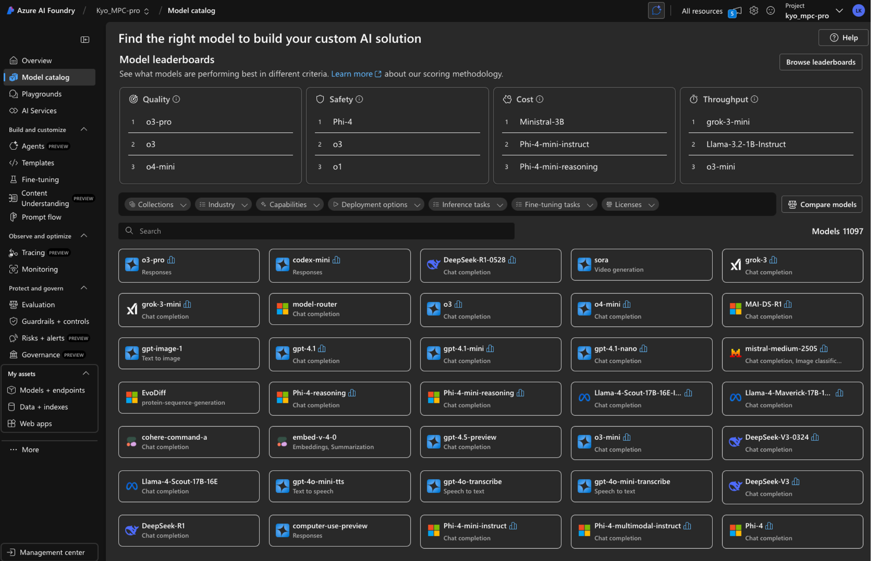
Infrastructure and Resources
Azure Services
  Azure Blob Storage for data storage
  Azure AI Search Service for data indexing/vectorizing
  Azure Foundry Portal to deploy multiple LLM models
Software stacks:
a. Python packages
b. JS/HTML/CSS + Open WebUI
c. SQLite

Slide 7
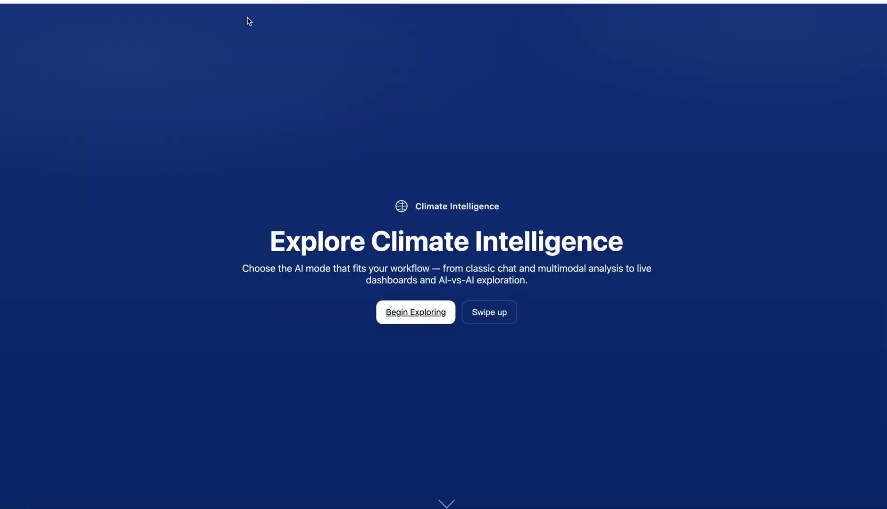
Interface Demo (LIVE)

Slide 8
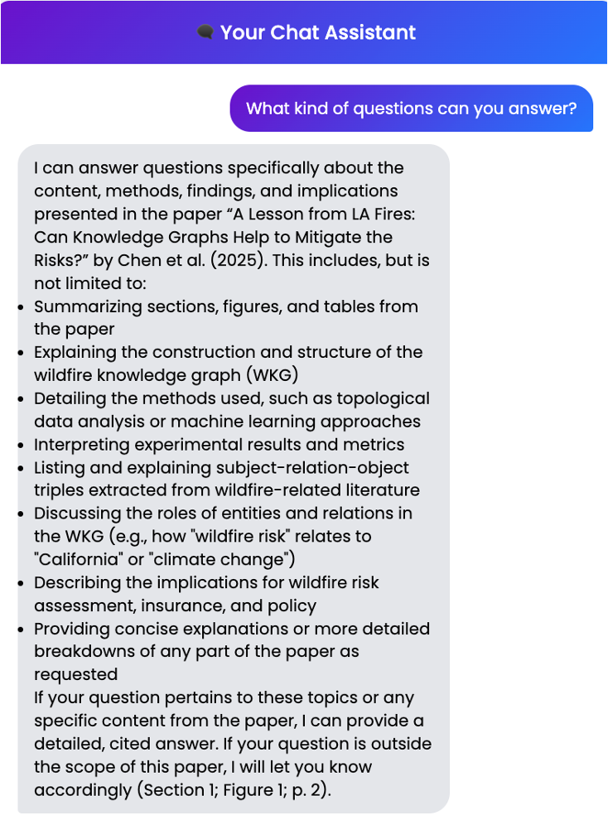
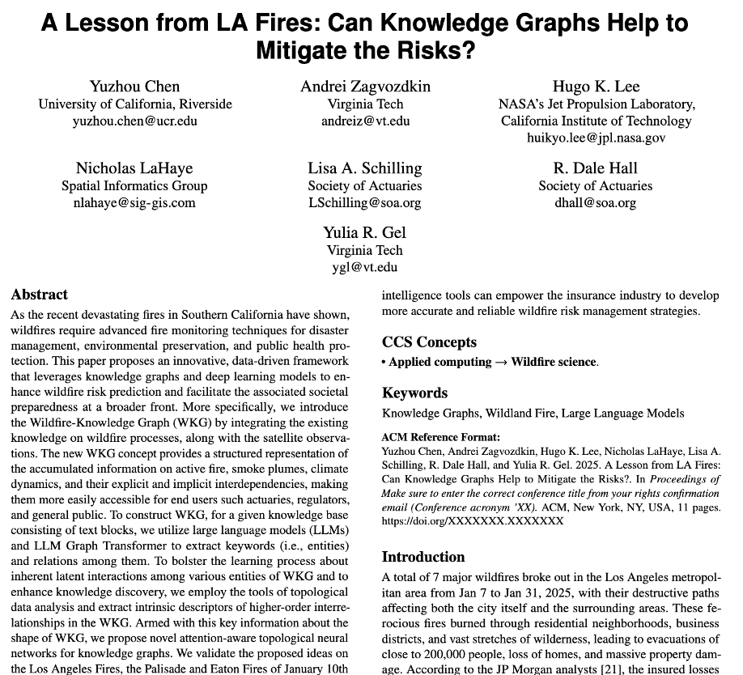

https://kg-kdd-bot.onrender.com/

Slide 9

Future Work
Integrate Model Context Protocol (MCP) for better results
Expand access to more NASA datasets (e.g., NEX-DCP30) and NASA’s Foundation Model for Earth (Prithvi)
Build a security layer to limit token usage

Slide 10
Acknowledgements
Kyo Lee (JPL)
Edwin Goh (JPL)
Valerio Pascucci (U. of Utah)
Juan Carlos Lopez (Microsoft)
Colin Raymond (UCLA)
and more…

Slide 11
Thank you!

